Slide 1
System of
Linear Equations
B.1

Slide 2






Equation Solving
A
B
Root
Finding
Linear
Algebra
non-linear
Single variable
linear
Multi variable
Open
Methods
Brackting
Methods
Direct
Methods
Iterative
Methods
Iterative
False-
position
Gauss
elimination
Jacobi’s
Newton-
Rapson
Bisection
Gauss-
Jordan
Gauss-Seidel
Secant
Choleski’s

Slide 3
Linear Algebraic Equations
An equation of the form ax+by+c=0 or
equivalently ax+by=-c is called a linear equation in x and y variables.
ax+by+cz=d is a linear equation in three variables, x, y, and z.
Thus, a linear equation in n variables is
a₁x₁+a₂x₂+ … +a_{n}x_{n} = b
A solution of such an equation consists of real numbers c₁, c₂, c₃, … , c_{n}
If you need to work more than one linear equations, a system of linear equations must be solved simultaneously.

Slide 4
Non-computer Methods for Solving Systems of Equations
For small number of equations (n ≤ 3) linear equations can be solved readily by simple techniques such as “graphical method”
Linear algebra provides the tools to solve such a system of linear equations
Nowadays, easy access to computers makes the solution of large sets of linear algebraic equations possible and practical

Slide 5
Solving Small Numbers of Equations
There are many ways to solve a system of linear equations:
  Graphical method
  Cramer’s rule
  Method of elimination
  Computer methods

Slide 6
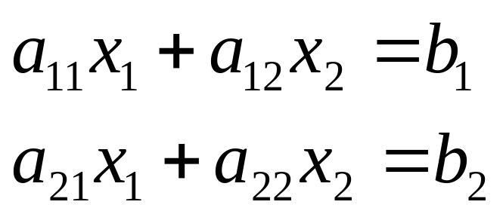
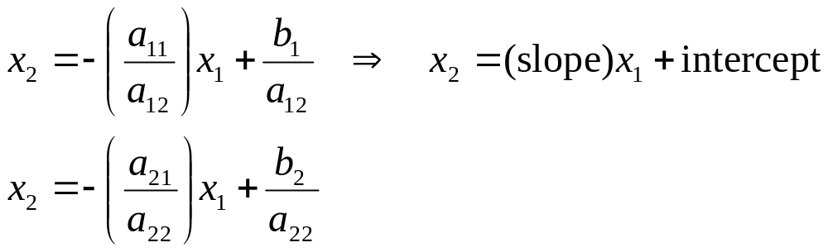
Graphical Method
For two equations:
Solve both equations for x_{2:}

Slide 7
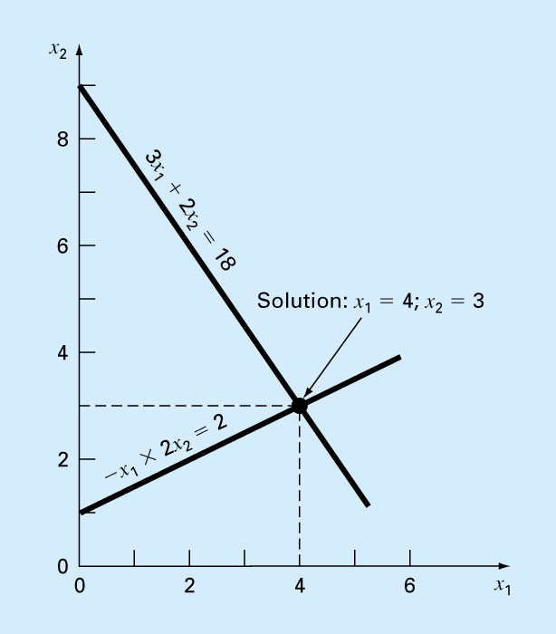
Graphical Method (Contd.)
Plot x₂ vs. x₁ on rectilinear paper, the intersection of the lines gives the solution

Slide 8
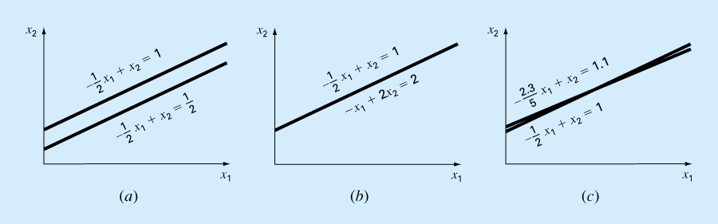
Graphical Method (Contd.)
        No solution
        Infinite solutions
        Ill-conditioned
        (Slopes are too close)

Slide 9
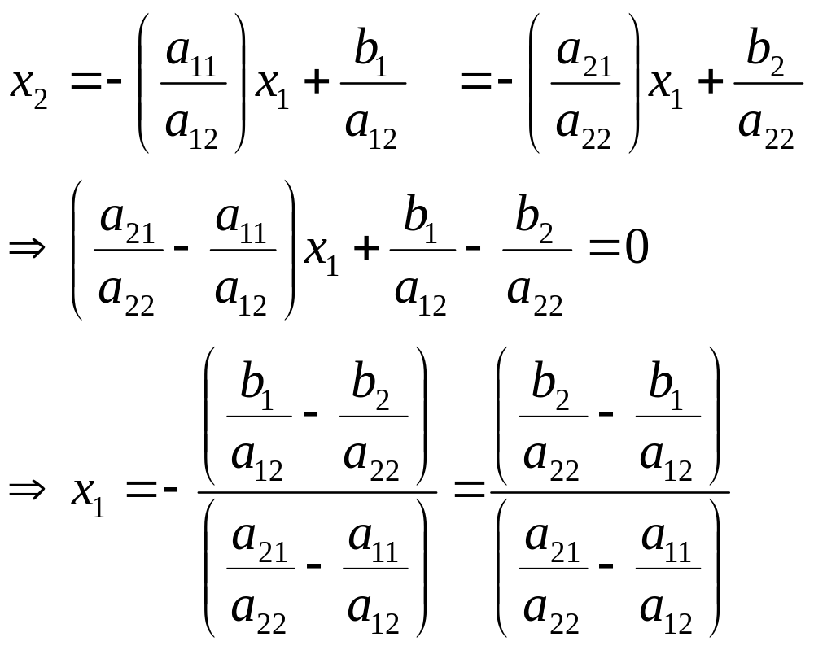
Algebraic Solution
Or equate and solve for x₁

Slide 10
Cramer’s Rule
Gabriel Cramer was a Swiss mathematician (1704-1752)
Cramer’s rule is another solution technique that is best suited to small numbers of equations

Slide 11
Cramer’s Rule (Contd.)
Each unknown in a system of linear algebraic equations may be expressed as a fraction of two determinants with denominator D and with the numerator obtained from D by replacing the column of coefficients of the unknown in question by the constants b1, b2,... , bn

Slide 12
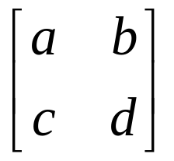
Coefficient Matrices
Can use determinants to solve a system of linear equations
Use the coefficient matrix of the linear system
Linear System Coefficient Matrix ax+by=e cx+dy=f

Slide 13

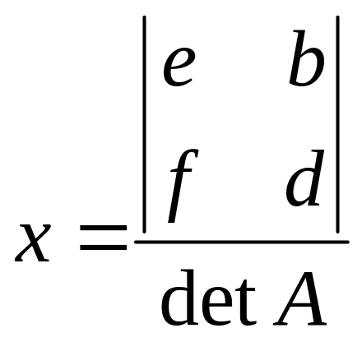
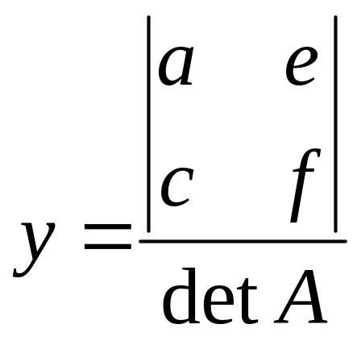
Cramer’s Rule for 2x2 System
Let A be the coefficient matrix
Linear System Coefficient Matrix ax+by=e cx+dy=f
If detA 0, then the system has exactly one solution
and

Slide 14
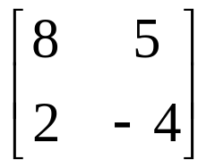
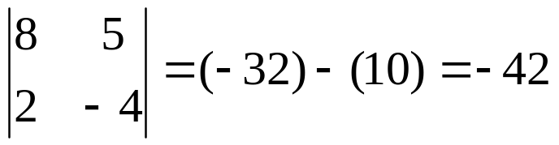
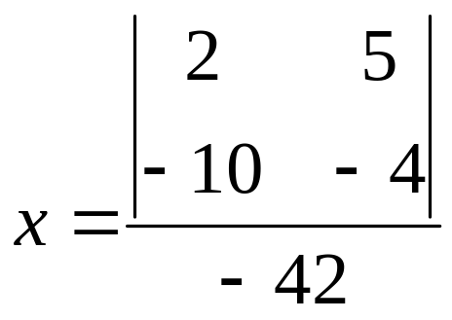
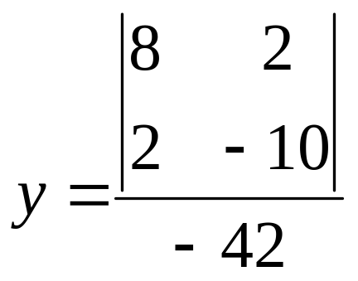
Example 1- Cramer’s Rule 2x2
Solve the system:
8x+5y=2
2x-4y=-10
Coefficient matrix is:
and

Slide 15
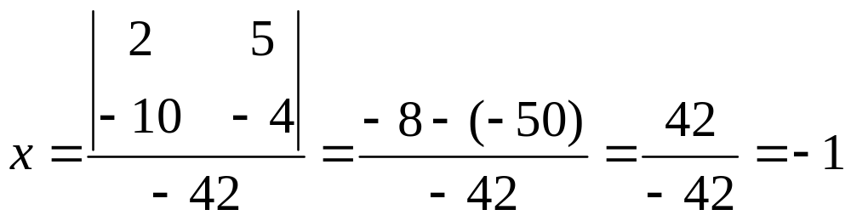
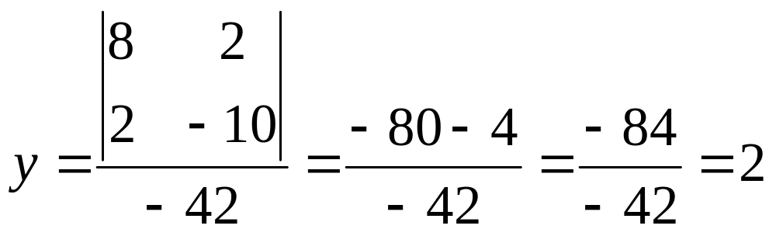
Example 1 (Contd.)
Solution: (-1,2)

Slide 16
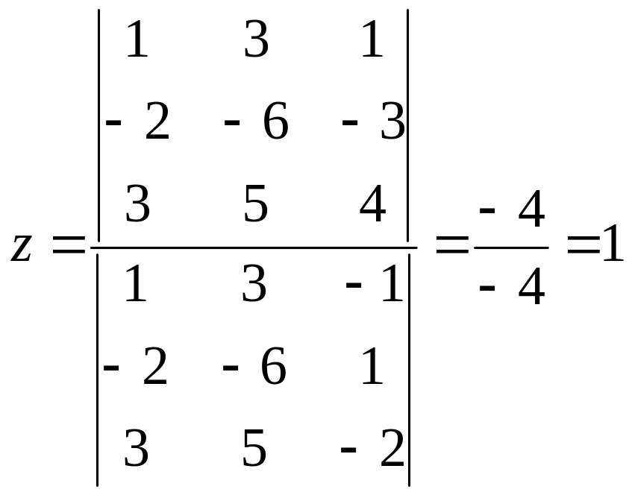
Example 2- Cramer’s Rule 3x3
Solve the system:
x+3y-z=1
-2x-6y+z=-3
3x+5y-2z=4
Let’s solve for Z
The answer is: (-2,0,1)!!!

Slide 17
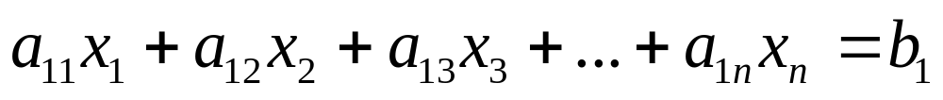

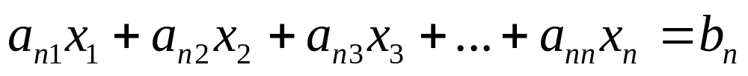
System of Linear Equations
A set of n equations and n unknowns
. .
. .
. .

Slide 18
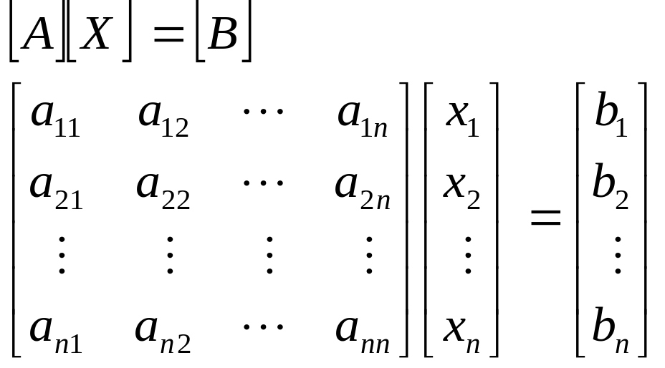
Gaussian Elimination
One of the most popular techniques for solving simultaneous linear equations of the form
Consists of 2 steps
1. Forward Elimination of Unknowns.
2. Back Substitution

Slide 19
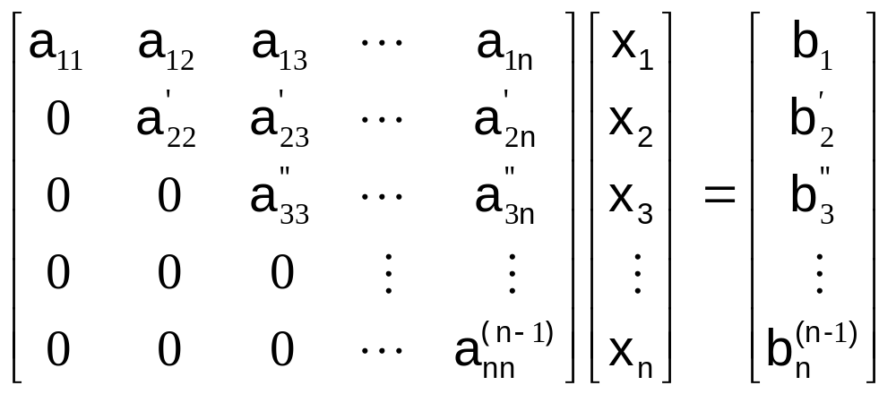
Forward Elimination
In general we get:

Slide 20
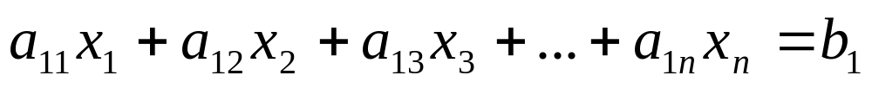
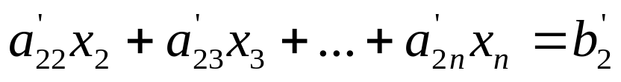
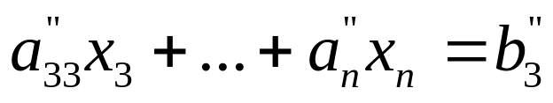
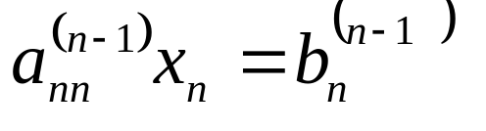
Forward Elimination
At the end of (n-1) Forward Elimination steps, the system of equations will look like:
. .
. .
. .

Slide 21
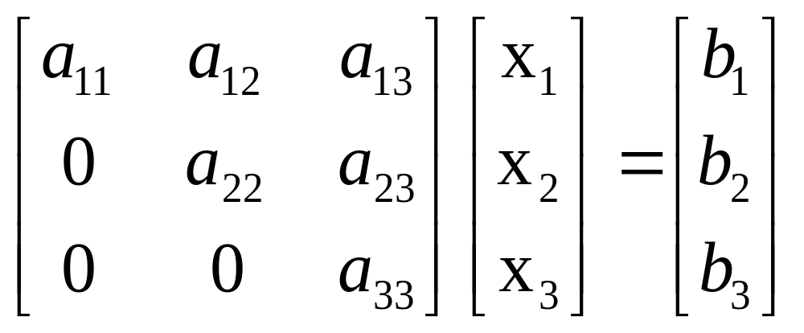
Back Substitution
The goal of Back Substitution is to solve each of the equations using the upper triangular matrix.
Example of a system of 3 equations

Slide 22
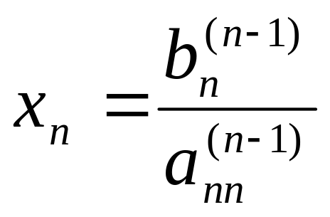
Back Substitution
Start with the last equation because it has only one unknown
Solve the second from last equation (n-1)^{th} using x_{n} solved for previously.
This solves for x_{n-1}.

Slide 23
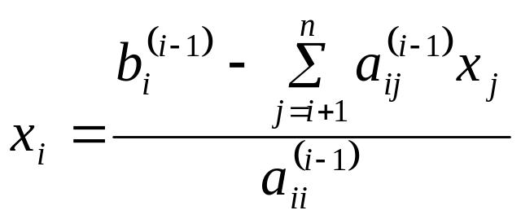

Back Substitution
Representing Back Substitution for all equations by formula
For i=n-1, n-2,….,1
and

Slide 24

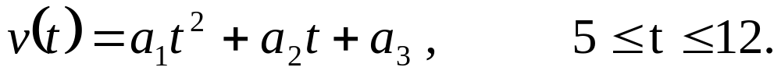
Example: Rocket Velocity
The upward velocity of a rocket is given at three different times
Time, t (s) | Velocity, v (m/s)
5 | 106.8
8 | 177.2
12 | 279.2
The velocity data is approximated by a polynomial as:
Find: The Velocity at t=6,7.5,9, and 11 seconds.

Slide 25

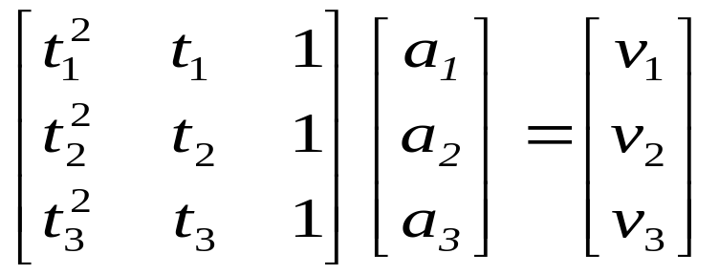

Example: Rocket Velocity
Assume
Results in a matrix template of the form:
Using date from the time / velocity table, the matrix becomes:

Slide 26
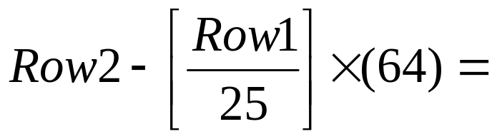
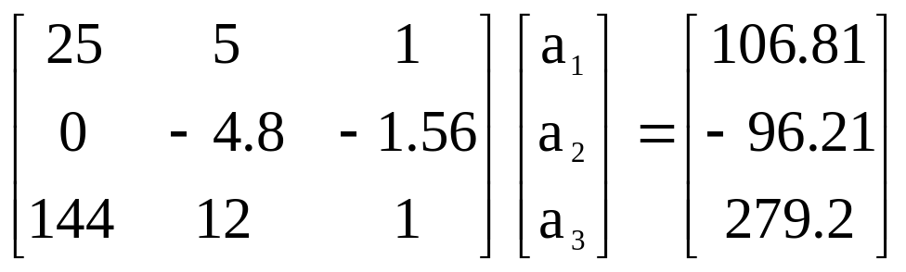
Example: Rocket Velocity
Forward Elimination: Step 1
Yields

Slide 27
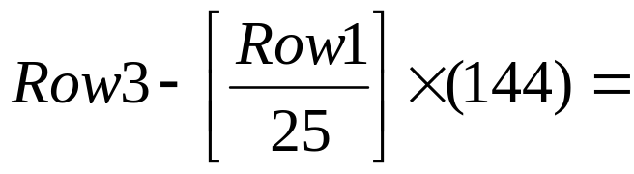
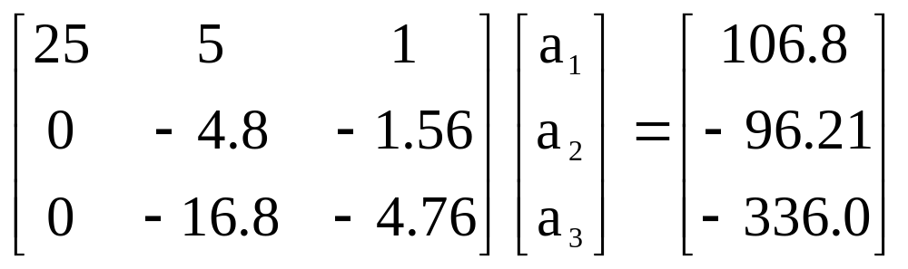
Example: Rocket Velocity
Forward Elimination: Step 1
Yields

Slide 28
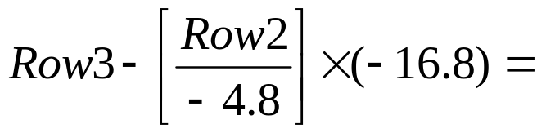
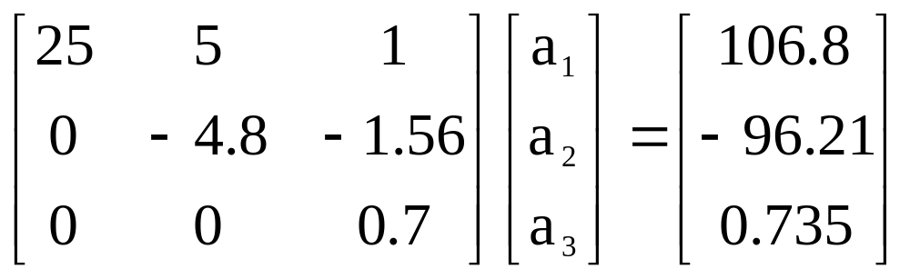
Example: Rocket Velocity
Forward Elimination: Step 2
Yields
This is now ready for Back Substitution

Slide 29
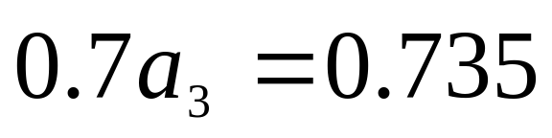
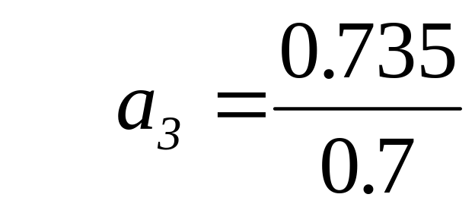
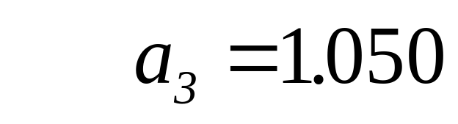
Example: Rocket Velocity
Back Substitution:
Solve for a₃ using the third equation

Slide 30
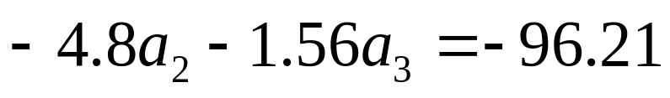
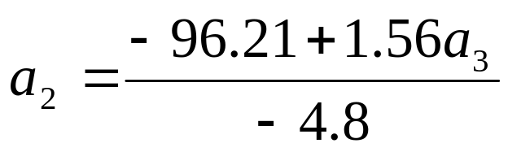
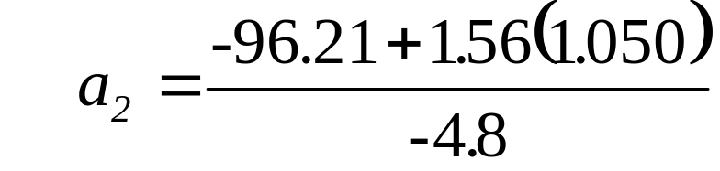
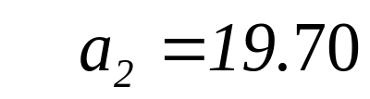
Example: Rocket Velocity
Back Substitution:
Solve for a₂ using the second equation

Slide 31
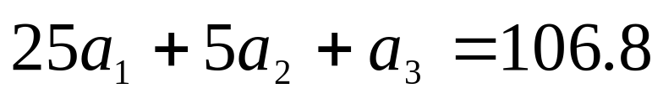
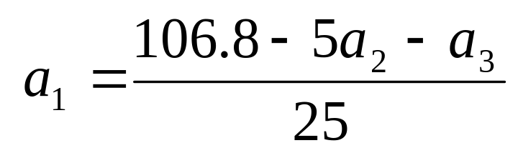
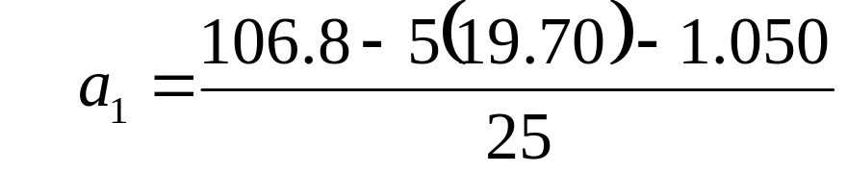

Example: Rocket Velocity
Back Substitution:
Solve for a₁ using the first equation

Slide 32
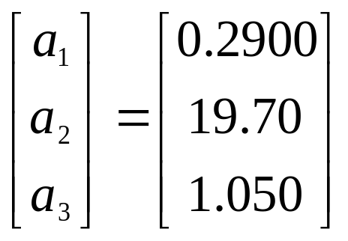
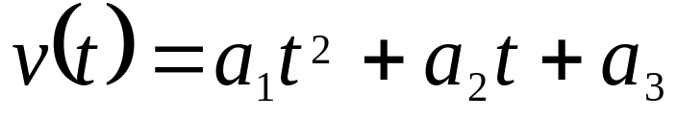
Example: Rocket Velocity
Solution:
The solution vector is
The polynomial that passes through the three data points is then:

Slide 33
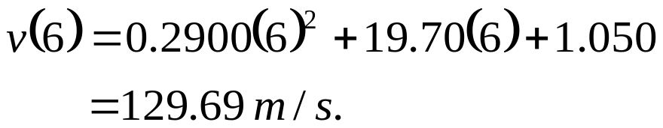
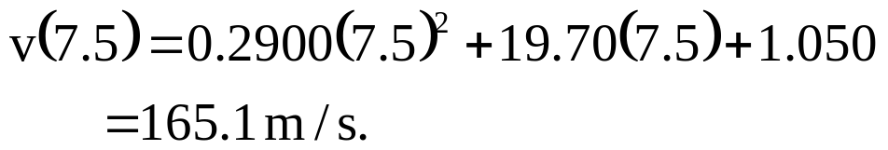
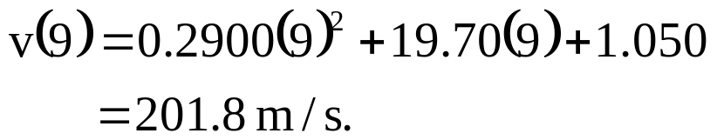
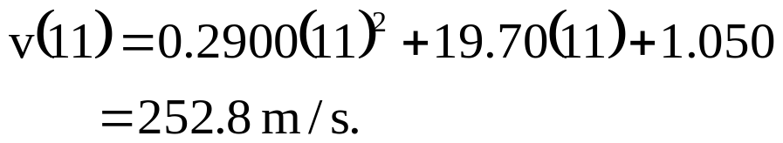
Example: Rocket Velocity
Solution:
Substitute each value of t to find the corresponding velocity

Slide 34

Pitfalls
Two Potential Pitfalls
Division by zero: May occur in the forward elimination steps. Consider the set of equations:
- Round-off error: Prone to round-off errors.

Slide 35






Pitfalls: Example
Consider the system of equations:
Use five significant figures with chopping
=
At the end of Forward Elimination
=

Slide 36




Pitfalls: Example
Back Substitution

Slide 37


Pitfalls: Example
Compare the calculated values with the exact solution

Slide 38
Improvements
Increase the number of significant digits
Decreases round off error
Does not avoid division by zero
Gaussian Elimination with Partial Pivoting
Avoids division by zero
Reduces round off error

Slide 39



Partial Pivoting
Gaussian Elimination with partial pivoting applies row switching to normal Gaussian Elimination.
How?
At the beginning of the k^{th} step of forward elimination, find the maximum of
If the maximum of the values is
In the p^{th} row,
then switch rows p and k.

Slide 40
Partial Pivoting
What does it Mean?
Gaussian Elimination with Partial Pivoting ensures that each step of Forward Elimination is performed with the pivoting element |a_{kk}| having the largest absolute value.

Slide 41




Partial Pivoting: Example
Consider the system of equations
In matrix form
=
Solve using Gaussian Elimination with Partial Pivoting using five significant digits with chopping

Slide 42



Partial Pivoting: Example
Forward Elimination: Step 1
Examining the values of the first column
|10|, |-3|, and |5| or 10, 3, and 5
The largest absolute value is 10, which means, to follow the rules of Partial Pivoting, we switch row1 with row1.
Performing Forward Elimination

Slide 43

Partial Pivoting: Example
Forward Elimination: Step 2
Examining the values of the second column
|-0.001| and |2.5| or 0.0001 and 2.5
The largest absolute value is 2.5, so row 2 is switched with row 3
Performing the row swap

Slide 44

Partial Pivoting: Example
Forward Elimination: Step 2
Performing the Forward Elimination results in:

Slide 45



Partial Pivoting: Example
Back Substitution
Solving the equations through back substitution

Slide 46


Partial Pivoting: Example
Compare the calculated and exact solution
The fact that they are equal is coincidence, but it does illustrate the advantage of Partial Pivoting

Slide 47
Summary
Forward Elimination
Back Substitution
Pitfalls
Partial Pivoting

Slide 48
Adapted from Prof. Autar Kaw

